Slide 1
1. SIMPLE PRESENT TENSE
a. Form
(+) S + V(S/ES 3rd singular) + O
(-) S + + V(base form) + O
Don’t
Doesn’t
(3rd singular)
(?) + S + V(base form) + O ?
Do
Does
(3rd singular)

Slide 2
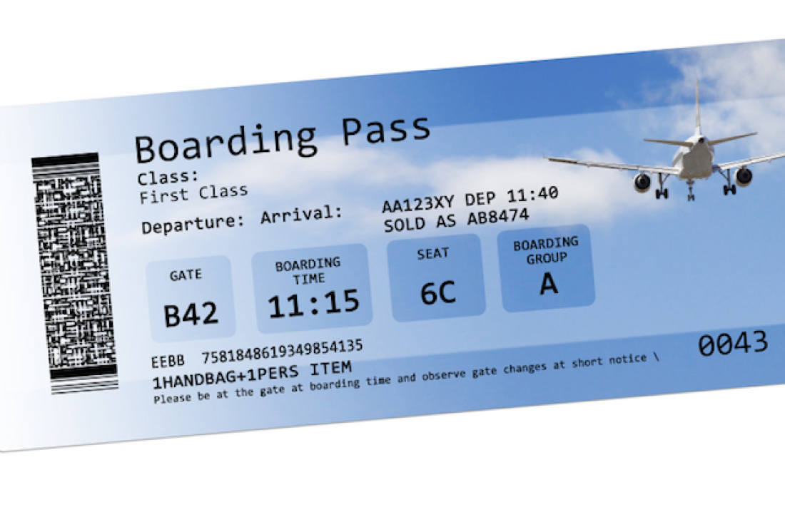

Slide 3


